Slide 1
Patient centered health care system coupled with AI medical chatbot.
Group: Amigos
Members:
Gaurav Shilimkar
Pankaj Shendurkar
Abhishek Shende
Kushal Shah

Slide 2
Objective
Healthcare utility which will help patients to be the owner of their data.
Allow the flow of data from patient side to any institution he wants to.
AI chatbot for medical assistance.

Slide 3
Background
Currently, the scattered form of data between different health institutions and different participants at each level has made the data interoperability a major problem.
We can’t afford to use different websites,apps and different data storage from each of these apps.
Patient can’t even show the previous digital medical records because xyz institution uses different technology compared to abc hospital.

Slide 4
Idea/Concept
Give priority to patient and make patient as the owner of his/her data.
Patient will get AI based medical assistance to help him decide the hospital visit.
Patient will have a storage wallet where he/she can store their all kind of medical data.
Patient will store all his health records by himself via scannable camera of mobile phone.
Patient will decide whom to share the data with, whoever he decides to share the data with , will get a QR code/link to scan it and see the data of the patient.
The patient can grant the access after the request and terminate it at any point of time.
Considering Patient as the central entity, each other players (doctors,laboratories,insurance companies) can request data from the patient about his all medical history (lab reports, bills, insurance papers, medical reports).

Slide 5
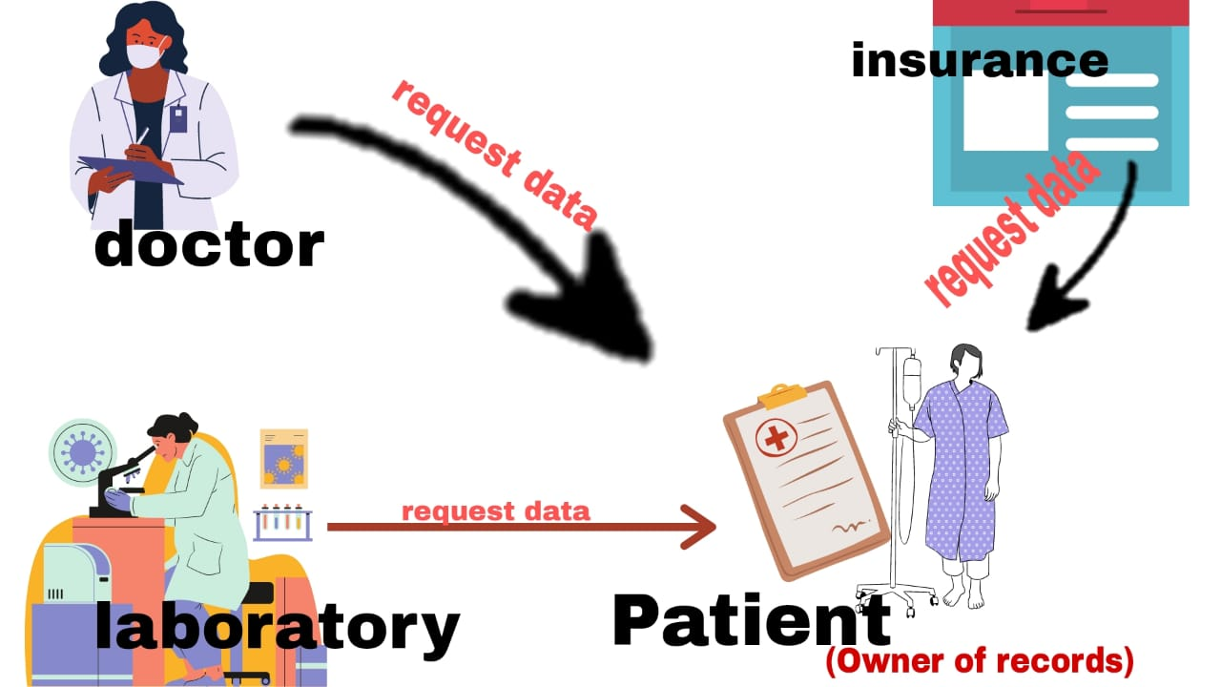
Let’s see how it works:

Slide 6
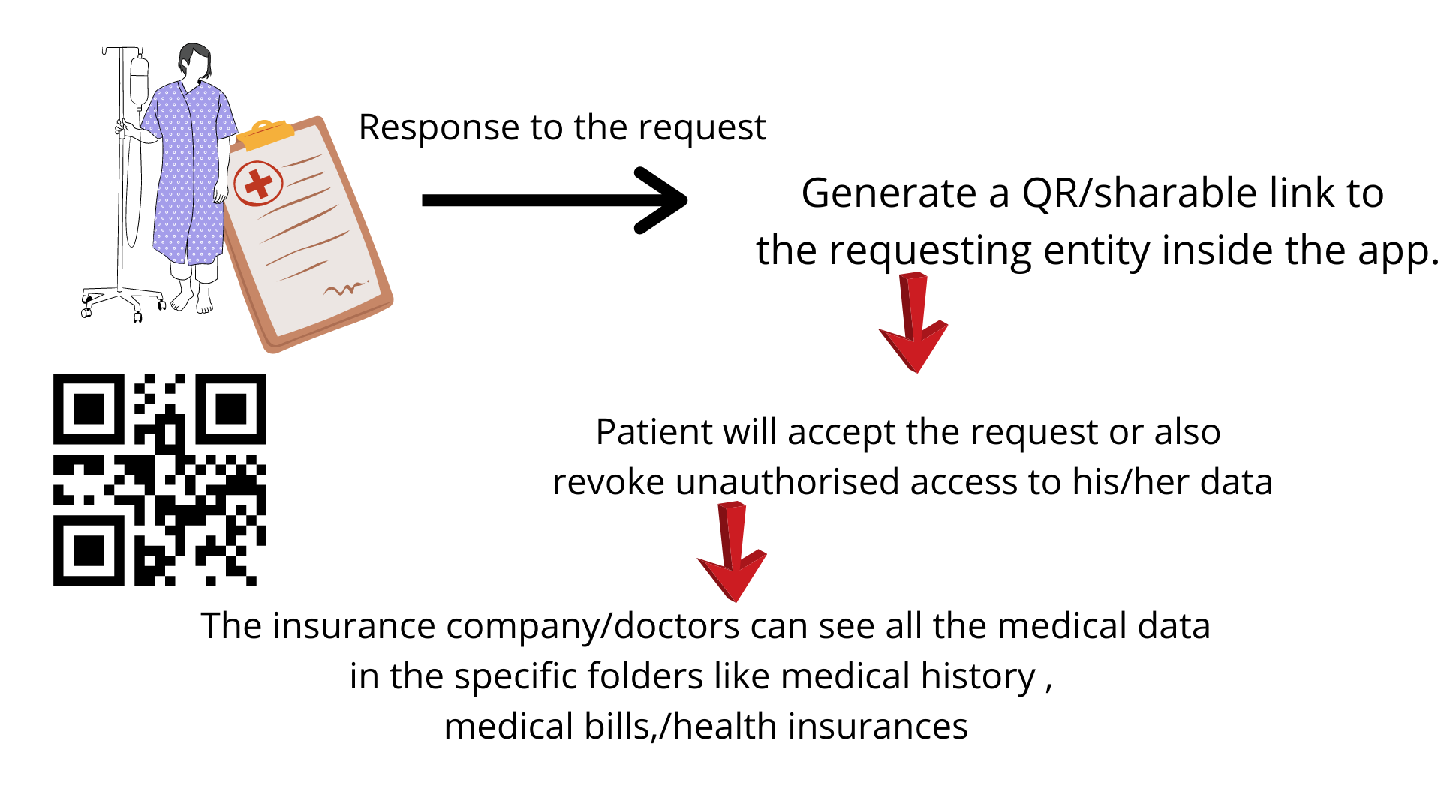
After request data , response from patient:

Slide 7
Conclusion:
This will mitigate the need for adding doctor data,creating all kinds of login for them.
Here , only patient is owner of data ,and with scan to use , the information seeker is just one scan away from knowing all the patient history.
With access revoke features, security problems are avoided.
With this kind of ease, even the most unsound person having no technical knowledge can just scan and use all the patient data.
With all this considered, there is zero need to carry physical files to hospitals, insurances.
With AI chatbot, common medical assistance can be given always.

